Slide 1
MayShow
Mobile App Engineering Final Project
Dec 2016
Mayday Team
Xuewei Li (xl356) | Shi Wang(sw712)
Junjie Feng(jf36) | Ruotian Zhang(rz88)

Slide 2
Project Description
Create a live videostream
Watch videos from all users
Search by username
Profile viewing
API: Kickflip SDK, Vitamio SDK
Database: Firebase

Slide 3
Programming goals and challenges
Goals
-Sign in/up by username
-Create a new live stream from a specific user
-Get all streams from API dynamically
-Display video streams by media
-Search and delete streams by username
Challenges
User info ------------> Firebase
Chatroom -----------> Firebase
Screen sharing---> Substituting the camera view by screen view

Slide 4
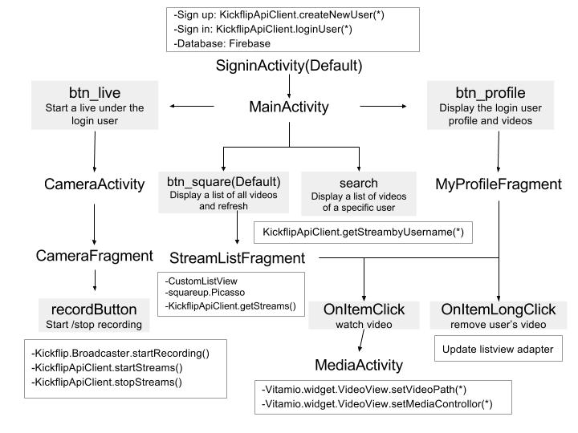
How the app works

Slide 5
Thanks for watching!

